Slide 1
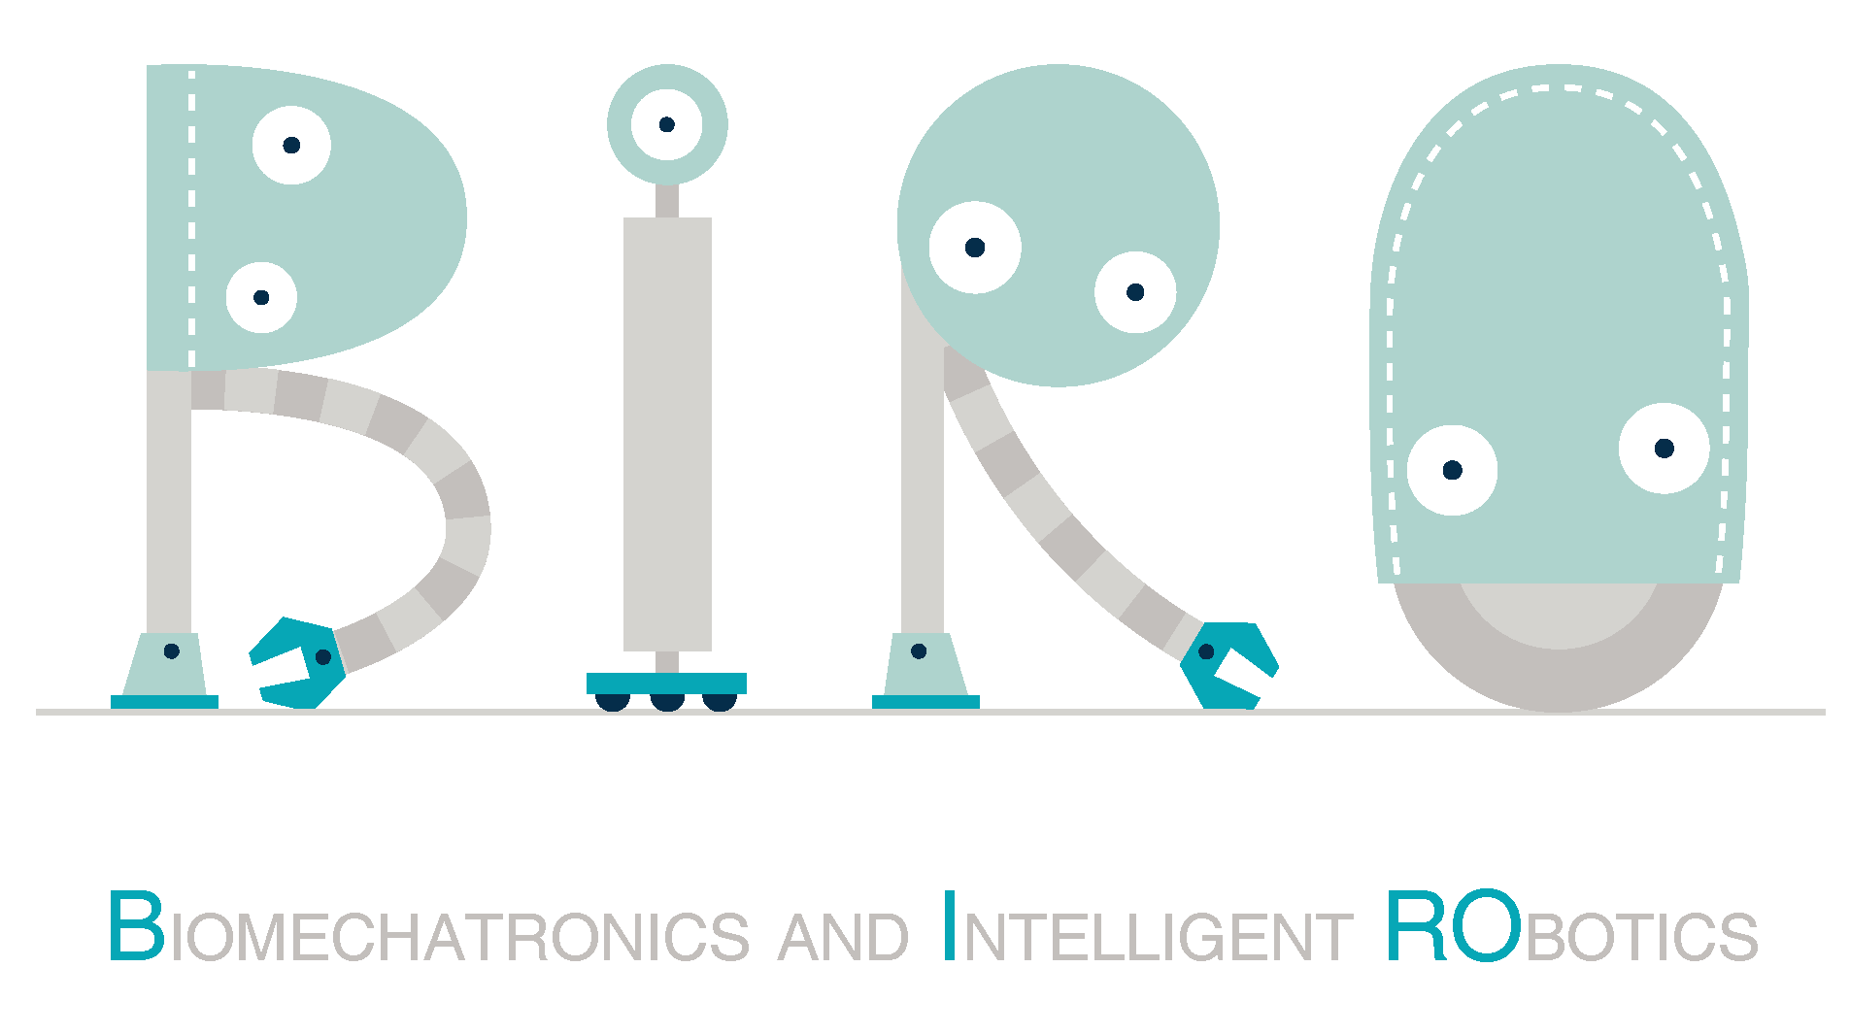



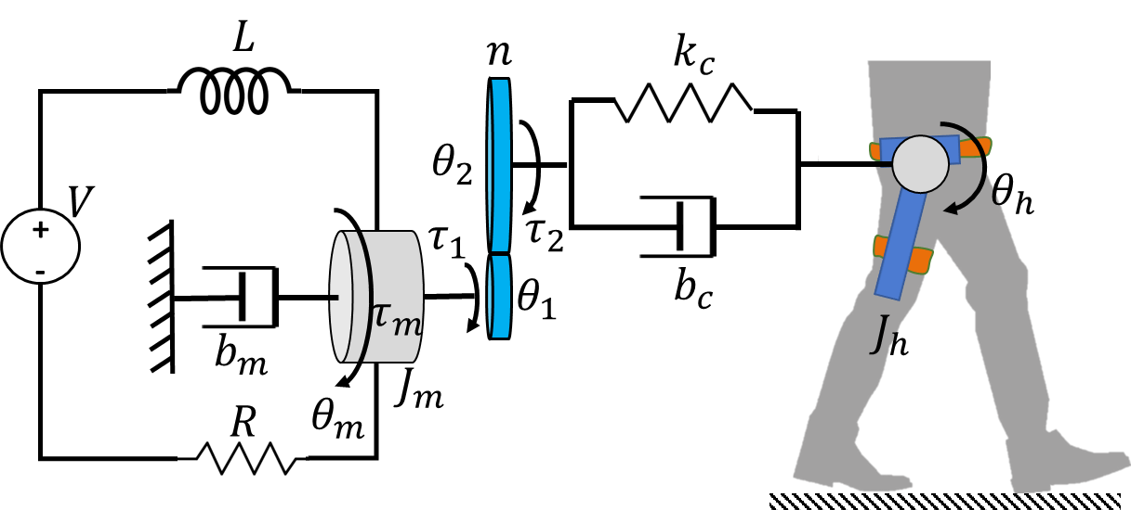
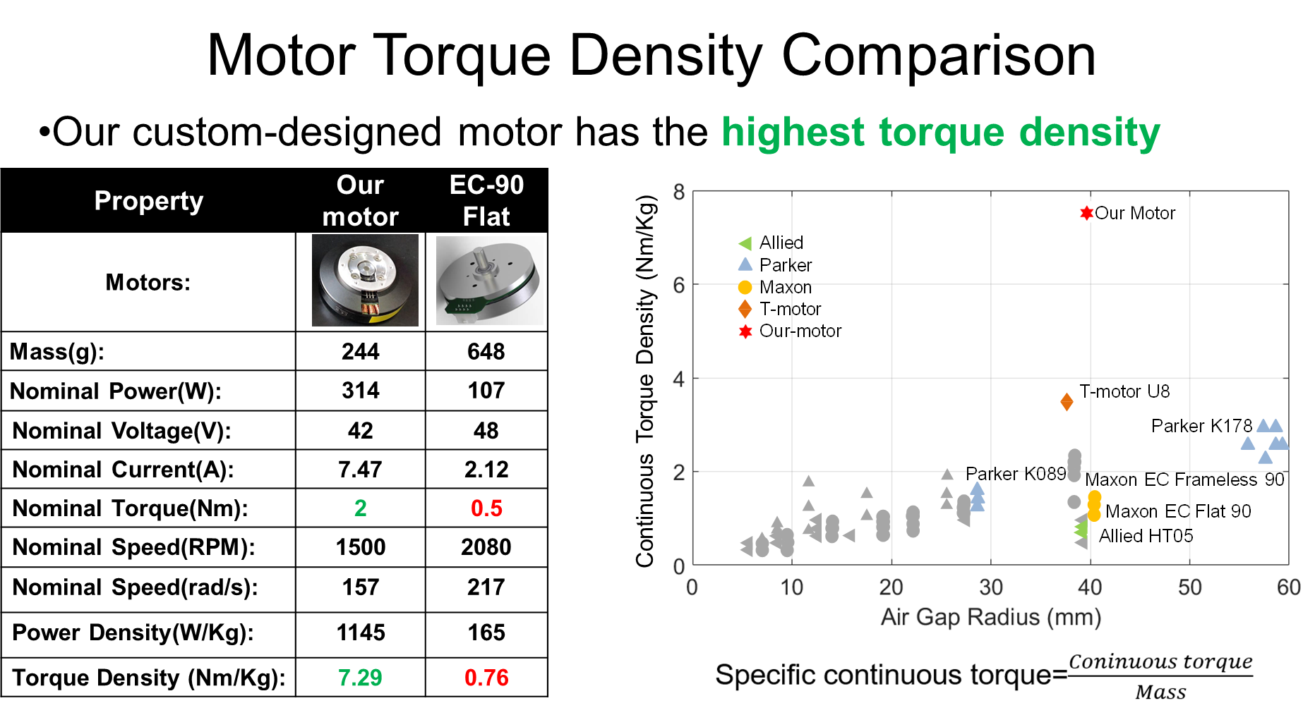
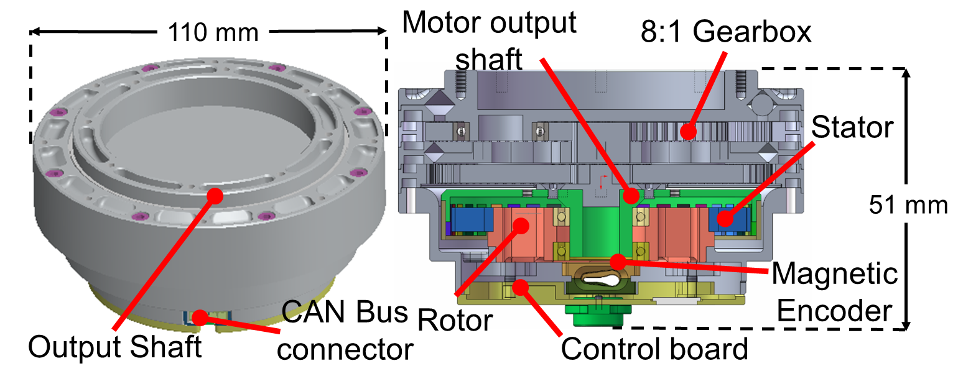
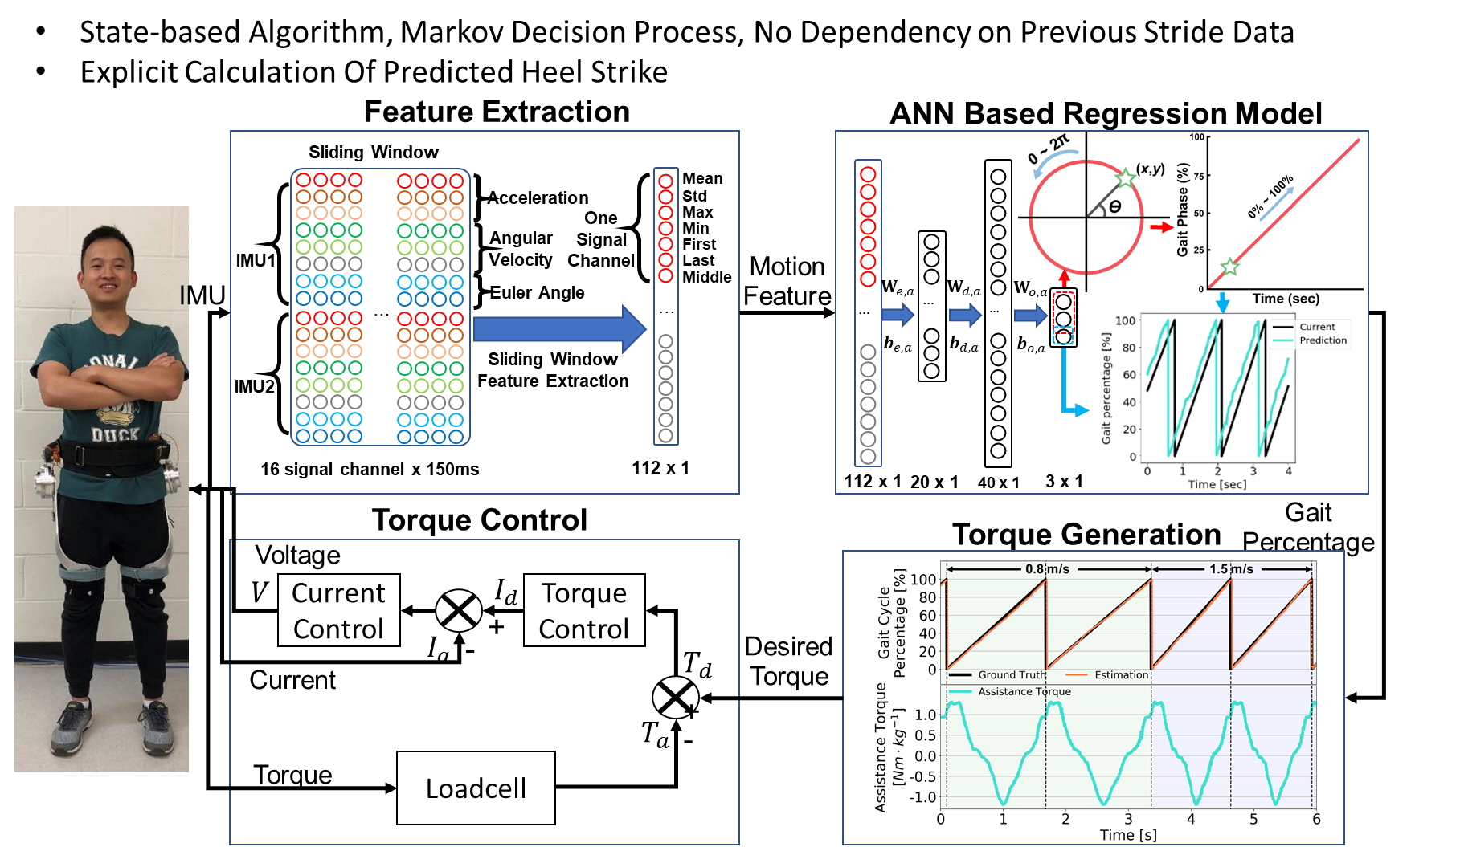
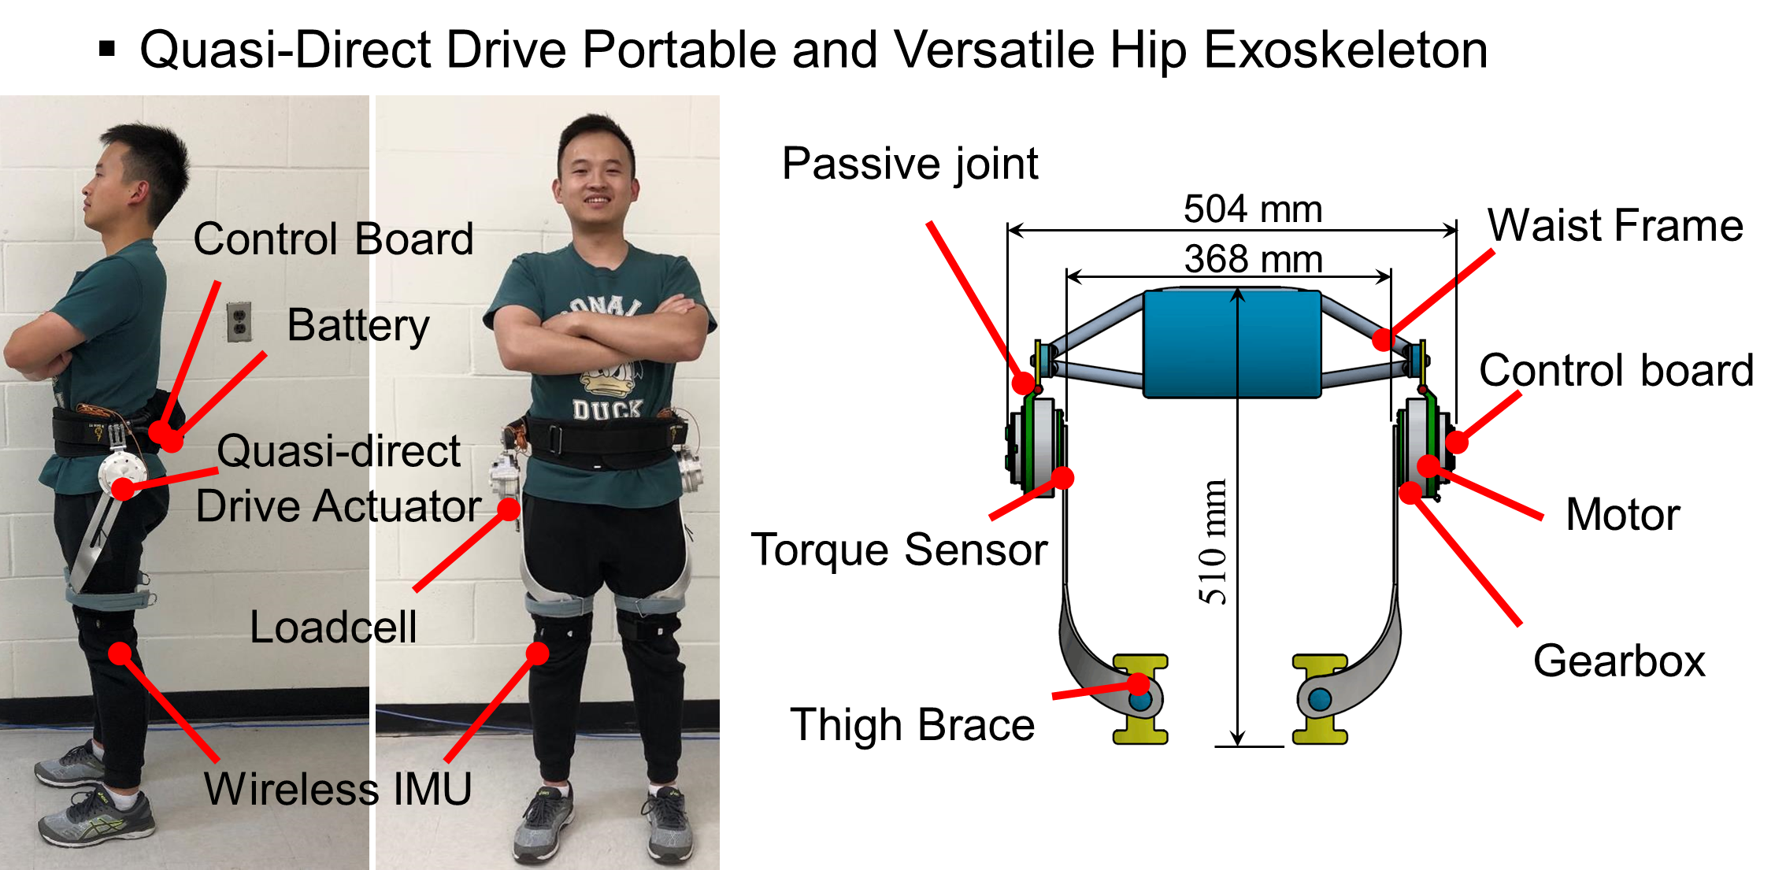
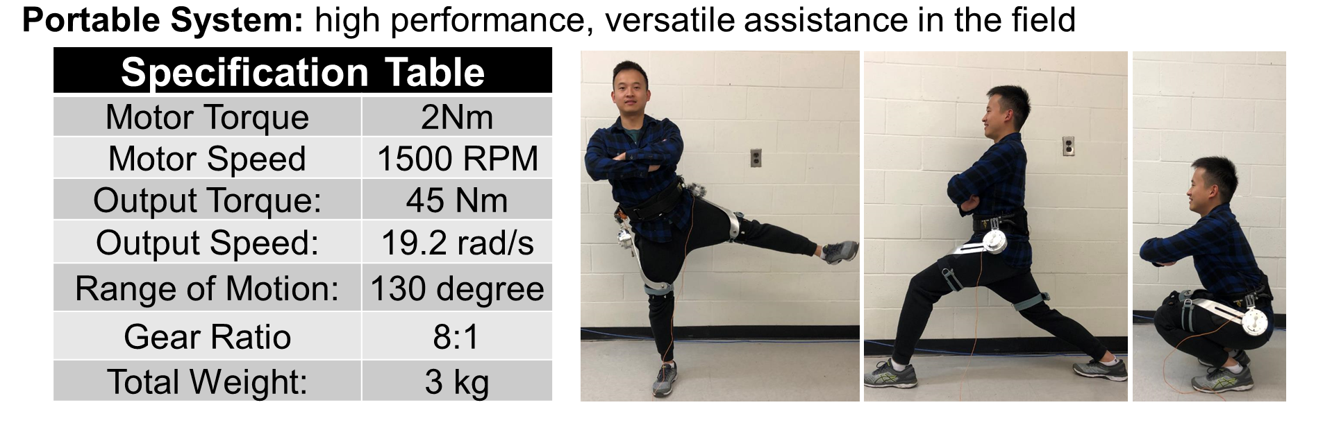
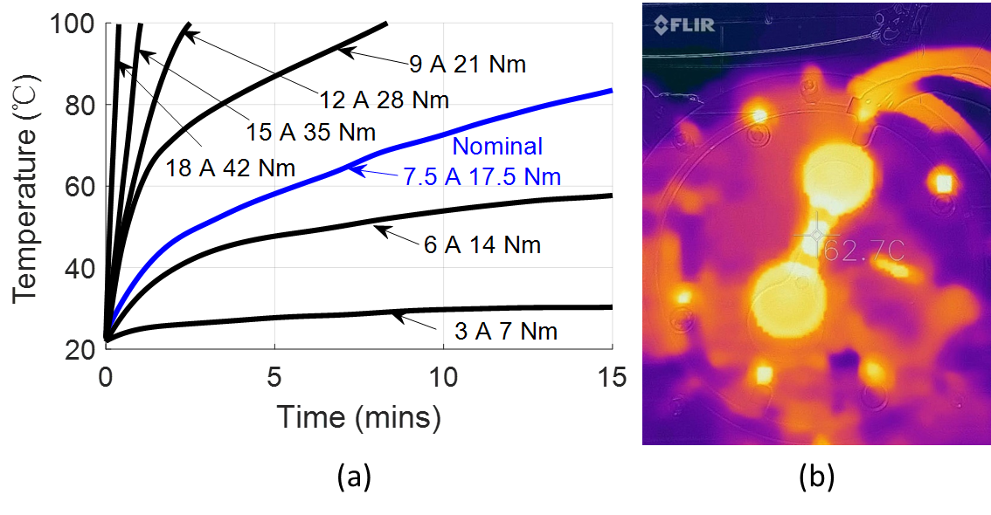
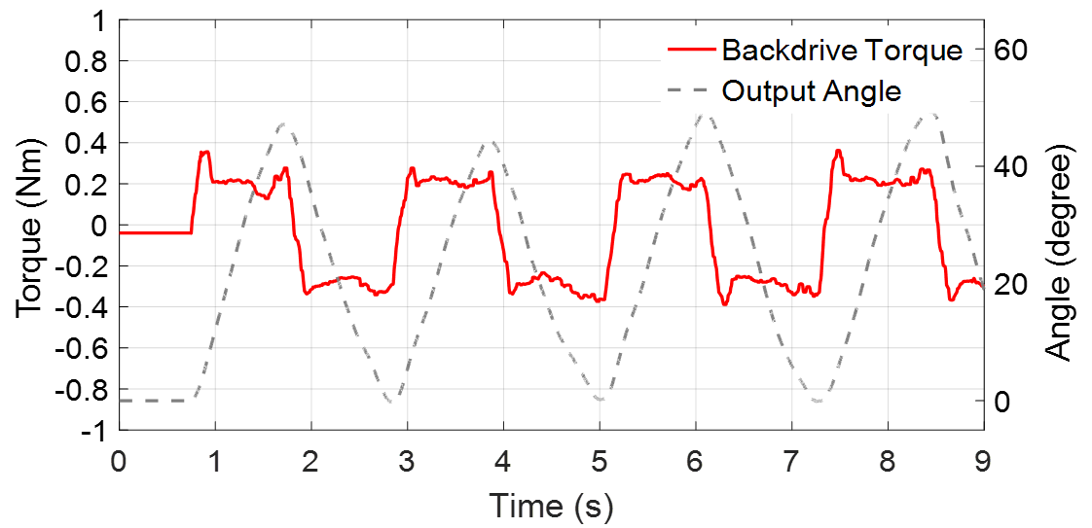
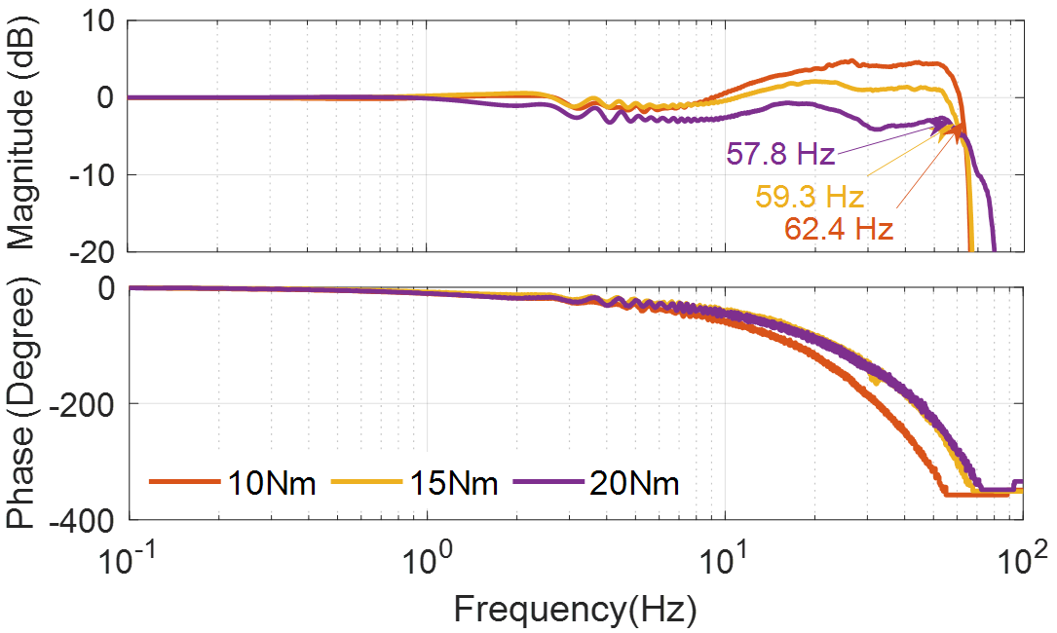
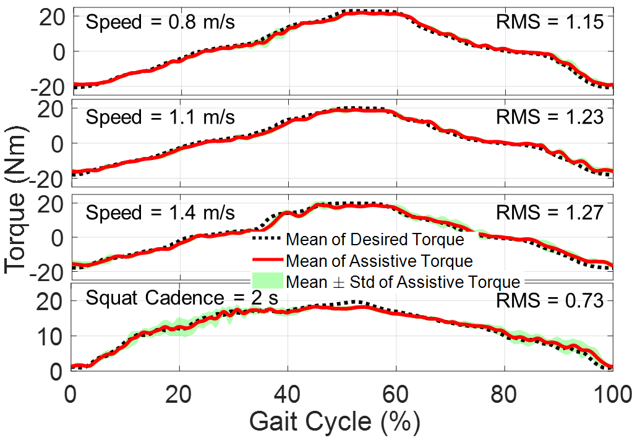



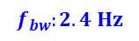
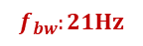
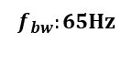
Lightweight and High Torque Hip Exoskeleton with Quasi-Direct Drive Actuation
Shuangyue Yu, Tzu-Hao Huang, Chunhai Jiao, Hang Hu, Sainan Zhang, Hao Su*
Biomechatronics and Intelligent Robotics lab, Department of Mechanical Engineering, City University of New York, City College, New York, NY, 10031, USA
Website: http://haosu-robotics.github.io
Email: hao.su@ccny.cuny.edu
Motivation / Introduction
Human-Exoskeleton Coupled Dynamic Model
High-performance actuators are crucial to enable mechanical versatility of wearable robots, which are required to be lightweight, highly backdrivable, and with high bandwidth.
State-of-the-art actuators, e.g., series elastic actuators (SEAs), have to compromise bandwidth to improve compliance (i.e., backdrivability).
we create a lightweight bilateral hip exoskeleton to reduce joint loadings during normal activities, including walking and squatting.
Human-exoskeleton coupled dynamic model
Quasi-Direct Drive Actuation
High Torque Density Motor
The bandwidth and backdrivability simulation result
$$f_{bw}:2.4 Hz$$
$$f_{bw}:21Hz$$
$$f_{bw}:65Hz$$
Quasi-Direct Drive Actuator
Human-Exoskeleton Coupled Dynamic Model
Sate-based Algorithm, Markov Decision Process, No Dependency on Previous Stride Data
Explicit Calculation of Predicted Heel Strike
Portable and Versatile Hip Exoskeleton
Quasi-Direct Drive Portable and Versatile Hip Exoskeleton
Experimental Result
Motor Nominal Current Evaluation
Exoskeleton Backdrive Torque Evaluation
(a) Stator temperature over time for different current conditions; (b) Thermal image after 15 min of continuous 7.5 A current operation. The actuator surface reached the maximum temperature of 62.7 ℃.
The backdrivability of the hip exoskeleton in the unpowered mode. The maximum torque of the mechanical resistance is approximately 0.4 Nm
Acknowledgment
Exoskeleton Bandwidth Evaluation
Torque Tracking for Walking and Squatting Assistance
This work is supported by the National Science Foundation grant IIS 1830613, CMMI -Career 1944655, NIH R01EB029765, and Grove School of Engineering, The City University of New York, City College.
Reference
[1] S. Yu, etc. Quasi-Direct Drive Actuation for a Lightweight Hip Exoskeleton with High Backdrivability and High Bandwidth. IEEE/ASME Transactions on Mechatronics, 2020.
[2] S. Yu, etc. Design and Control of a High-Torque and Highly Backdrivable Hybrid Soft Exoskeleton for Knee Injury Prevention During Squatting. IEEE Robotics and Automation Letters, 2019.
[3] J. Yang, etc. Machine Learning Based Adaptive Gait Phase Estimation Using Inertial Measurement Sensors. Design of Medical Devices Conference. American Society of Mechanical Engineers Digital Collection, 2019
Bode plot for 10 Nm, 15 Nm, and 20 Nm torque control. The high bandwidth (highest value is 62.4 Hz) demonstrates the ability to handle high-frequency movements of humans
Torque tracking performance of ±20 Nm assistance during walking and squatting tests. 1.09 Nm root mean square tracking error, 5.4% of the desired peak torque

